Slide 1
Home and Community Based Services Waiver Integration Project Public Information & Listening Session

Slide 2
What to Expect Today
2 hours, no break, feel free to get up as needed. Refreshments are available.
KDADS and KDHE will provide a brief update about the waiver integration process
Table Discussion
Large Group Discussion

Slide 3
Alphabet Soup
AAA: Area Agencies on Aging
ADRC: Aging and Disability Resource Center
CDDO: Community Developmental Disability Organization
CHIP: Children’s Health Insurance Plan
CMHC: Community Mental Health Centers
CMS: Centers for Medicare and Medicaid Services
DSW: Direct Service Worker
EPSDT: Early and Periodic Screening, Diagnosis, and Treatment
FMS: Financial Management Services
HCBS: Home and Community Based Services
KDADS: Kansas Department on Aging and Disability Services
KDHE: Kansas Department of Health and Environment
MCO: Managed Care Organization
MFP: Money Follows the Person
PACE: Program for All-Inclusive Care for the Elderly
PCA: Personal Care Assistant
TCM: Targeted Case Management

Slide 4
Waiver Programs Affected
Autism
Frail Elderly (FE)
Intellectual/Developmental Disability (I/DD)
Physical Disability (PD)
Serious Emotional Disturbance (SED)
Technology Assisted (TA)
Traumatic Brain Injury (TBI)

Slide 5
KanCare Waiver Integration Project
November 2015

Slide 6
KanCare Overview
History
Kansas moved most services and supports into a program called KanCare.
KanCare allows the state to provide all Home and Community Based Services (HCBS) through managed care.
Currently, the HCBS programs (1915(c) waivers) operate alongside the 1115 waiver.
Notes:
In 2013 and 2014 most Medicaid services were moved into KanCare including the HBCS waivers.

Slide 7
KanCare Services
Under KanCare, more than 400,000 Kansans get:
Doctor visits and hospital care
Mental health therapy
Dental and eye care
Medicine
Help getting to doctor visits
Nursing home care
Extra (or value-added) services
Notes:
In 2013 and 2014 most Medicaid services were moved into KanCare including the HBCS waivers.

Slide 8
HCBS Programs under 1915(c)
Waiver | PEOPLE Served
Autism | People who are 0-5 with Autism Spectrum Disorder (ASD)
Frail Elderly | People who are over age 64 and frail (FE)
Intellectual and Developmental Disability | People who are 5 and older with intellectual disabilities and developmental disabilities (IDD)
Physical Disability | People who are 16-64 with physical disabilities (PD)
Serious Emotional Disturbance | People who are 4-21 with serious emotional disturbance (SED)
Technology Assisted | People 0-21 who are medically fragile and technology dependent (MFTD) ages 0-21
Traumatic Brain Injury | People who are 16-64 with traumatic brain injury (TBI)
Under the 1915(c) waivers, more than 25,000 individuals receive long-term services and supports in one of seven waivers:

Slide 9
(now)
1115 Demonstration
1915(c) Waivers
All Medicaid services in State Plan
Gives State authority to provide all services, including 1915(c) services, through managed care to all populations
Allows State to operate seven 1915(c)/HCBS waivers alongside the 1115 demonstration
All HCBS waiver services provided under managed care
Operate alongside
Autism
FE
IDD
PD
SED
TA
TBI

Slide 10
Why Integrate the Waivers – Part 1
To create parity for populations served through Home and Community Based Services (HCBS) – services should be based on a personalized plan of care and centered on an individual’s needs rather than their disability
To offer a broader array of services – some individuals have disabilities that qualify them for more than one HCBS program, but they are limited to a single set of services
Notes:
Presently, when a person is determined financially and functionally eligible for an HCBS program, they are limited to a specific package of services even if they could benefit from a service on another HCBS program.
There are also people who qualify for more than one HCBS program who then must choose one program and one package of services.
At times people transition from one HCBS program to another. For example a person with physical disabilities may want to transition to the HCBS program for the frail elderly. Or children move from the TA HCBS program to the IDD or PD HCBS program. Waiver integration would mean fewer and smoother transitions.
As part of this initiative, we will propose some new services, as well as offering some existing services to more populations.
We expect this integration to eliminate some redundant reporting and multiple waiver amendments, extensions and renewals – all of which are very time-consuming and do not add value to supporting people to live in the community.

Slide 11
Why Integrate the Waivers – Part 2
To improve moves between HCBS Programs and in transitioning from child to adult services
To support development and expansion of community-based services
To make things simpler for KanCare members, their families, and providers
Notes:
We want to offer essentially two packages of services.
We plan to retain the current eligibility pathways for determining functional eligibility for HCBS. The current entities that assess people for HCBS would continue to do so. For example, the Aging and Disability Resource Center will continue to complete assessments for the FE, PD and TBI populations.
All the current coverage of services within KanCare provided through the state plan would continue. So any service that is demonstrated as medically necessary and covered would be provided.
HCBS will still be based upon what is authorized in an individual’s plan of care, developed through an assessment and person-centered process

Slide 12
How Will Waiver Integration Work
Full integration of seven 1915(c) waivers into the 1115 waiver
Entrance to HCBS will remain the same, but services will fall into two broader categories:
Children’s Services
Adults’ Services
Notes:
We want to offer essentially two packages of services.
We plan to retain the current eligibility pathways for determining functional eligibility for HCBS. The current entities that assess people for HCBS would continue to do so. For example, the Aging and Disability Resource Center will continue to complete assessments for the FE, PD and TBI populations.
All the current coverage of services within KanCare provided through the state plan would continue. So any service that is demonstrated as medically necessary and covered would be provided.
HCBS will still be based upon what is authorized in an individual’s plan of care, developed through an assessment and person-centered process.

Slide 13
(after waiver integration)
1115 Demonstration
All Medicaid services in State Plan
Authority to provide all services through managed care to all populations
Includes KanCare CommunityCare (HCBS)
Children with Autism
Children who are medically fragile and need TA
Children with SED
Children with IDD
Youth 16+ with PD
Youth 16+ with TBI
Children’s Benefit Plan
Adults who are FE
Adults with IDD
Adults with PD
Adults with TBI
Adults’ Benefit Plan

Slide 14
Core Features of Waiver Integration
Core Features
Eligibility requirements and process will remain the same
Children will continue to be entitled to all medically necessary services identified through Early Periodic Screening Diagnosis and Treatment (EPSDT)
All members will continue to be entitled to medically necessary state plan services that are part of KanCare
Services will be authorized through personalized plans of care
Notes:
.

Slide 15
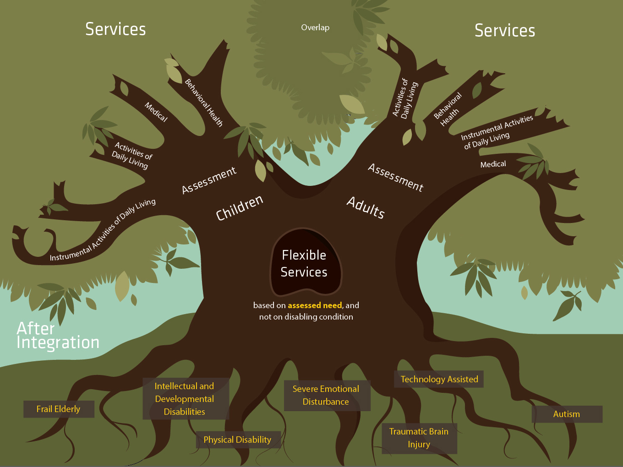

Slide 16
Stakeholder Input
Waiver Integration Stakeholder Engagement (WISE) Workgroup:
Almost 100 stakeholders representing all disability groups, providers, consumers and families
Five focus groups worked on specific areas –
Access, eligibility and navigation
Service provision and limitations
Provider qualifications and licensing
Policy and regulation review
Education, training and communication
Four 4-hour meetings with work in between
Numerous recommendations

Slide 17
WISE Workgroup Recommendations
Access, Eligibility and Navigation:
Waitlists
Eliminate if possible
Cost savings should be applied to waitlist reduction
No change to pathway to eligibility
Eliminate the child and adult population service packages and combine into one
Develop basic 1115 waiver training and deliver to interested stakeholders

Slide 18
WISE Workgroup Recommendations
Service Provision and Limitations:
Expand employment supports
Combine certain services
Establish new services
Notes:
Combine Services
All personal care assistance services will be combined to a single service.
All respite care except medical respite should be combined. Medical respite should remain a separate service due to provider qualifications and duties
Medical Alert/Personal Emergency Response System services should be combined. Installation should remain a separate service.
Health Maintenance/ Wellness monitoring should be combined.
Assistive Services, Assistive Technology and Home Modification can be combined.
New Services
Sign Language Therapy
Support Service Provision
This service provides visual communication facilitation for consumers who are blind or deaf/blind.
Support Broker/ Service Coordinator
This service would provide the hands-on support needed by consumers that is not currently available for some populations and is not billable though Targeted Case Management.

Slide 19
WISE Workgroup Recommendations
Provider Qualifications and Licensing:
Reduce administrative burdens and streamline processes for providers
Ensure qualified providers
3. Maintain choice for providers and participants

Slide 20
WISE Workgroup Recommendations
Policy and Regulation Review:
Develop an Operational Council to assist with policy review and development specific to waiver integration.
Develop a Policy Advisory Council to assist State staff in the development and revision of policy.
Develop a specific plan for communication regarding regulation and policy.
Collaborate with stakeholders to write an integrated waiver program manual and develop policies to further operationalize aspects of the program manual.

Slide 21
WISE Workgroup Recommendations
Education, Training and Communication:
Make sure all documents use both person-first language and plain language at the sixth grade level.
Continue to bring state staff and all stakeholders together to communicate, collaborate, and work together.
Utilize a variety of mediums to provide training and education.
Require provider training on integrated waiver before providers are allowed to provide waiver services.

Slide 22
How Can You Help Us With Waiver Integration?
Ask questions
Share what you’ve heard today with others
Print information from the website to share with people who don’t have internet access
Provide us feedback through comments on the draft amendment once it is posted
Watch for more information and details

Slide 23
Next Steps
Use recommendations, stakeholder input and MCO help to develop adult’s and children’s benefit plans
Work with actuaries to develop service reimbursement rates
Draft the 1115 demonstration amendment
Post the draft amendment for public comment
Review comments
Officially submit amendment to CMS for a January 1, 2017 implementation

Slide 24
Discussion Questions
What sounds promising to you about the updates and recommendations you’ve heard?
What would you like the State to keep in mind as it moves forward?
What additional questions or
comments do you have?

Slide 25
More Resources
Information about KanCare:
www.kancare.ks.gov
Information about waiver integration:
http://www.kancare.ks.gov/section_1115_waiver.htm
OR
www.kdads.ks.gov
To provide feedback, email:
hcbs-ks@kdads.ks.gov

Slide 26
Thank you for coming!
Upcoming Meetings: Thursday, Nov. 12 @ 1:30 p.m. and 5:30 p.m. Wichita - Airport Doubletree by Hilton & Kansas City - Hilton Garden Inn Monday, Nov. 16 @ 1:30 p.m. and 5:30 p.m. Hays - Fort Hays State Memorial Union & Pittsburg - Holiday Inn Express
Informational Conference Calls: Friday, Nov. 13 @ 12:00 p.m. OR Tuesday, Nov. 17 @ 5:30 p.m. Dial: 1-866-620-7326 Enter Code: 527-268-5242

